Slide 1
Strategic Planning for the Future
June 16, 2016

Slide 2
Agenda
Introductions & Expectations
The Anatomy of a Strategic Plan
Ingredients for Successful Implementation
What Will You Do Differently?
Closing Thoughts

Slide 3
Introductions
Professional Experience
CTY Consulting Group, LLC
Strategy Development
Organizational Development
Innovation Development
Process Improvement
Back Office Services
WellSpan Health
The Wolf Organization, Inc.
Education
BS Accounting – Penn State
MBA – Johns Hopkins
Volunteer Experience
American Red Cross – Southcentral PA Chapter, Chair, Board of Directors
United Way of York County, Public Policy Committee & Affiliations Committee (past chair, Board of Directors)
York County Solid Waste Authority, Board Member

Slide 4
Your Expectations for Today?
What specific takeaway would you like from today’s session?
Are there parts of the planning process with which you have struggled in the past?

Slide 5
Anatomy of a Strategic Plan
Mission Statement
What you do day in and day out
Guides the daily activities, priorities, decision-making
Does your mission statement accurately describe what your organization does day-to-day and guide your decision making?
Is it visible and accessible to all?
Vision Statement
What you aspire to be
Is it a shared vision?
Values Statement
The values that guide and define your organization
Are they shared values?
Will they be the same 50 years from now?

Slide 6
Anatomy of a Strategic Plan (cont’d)
Strategic Assumptions
Key assumptions about the environment that guide future priorities
Have you included everything? (e.g. demographics, technology, competition, funding, demand for services, risks to the organization, etc.)
Value Proposition
What makes your organization unique and what value do you deliver in the market
Can you articulate your value proposition? What makes you different?

Slide 7
Anatomy of a Strategic Plan (cont’d)
Strategic Imperatives
Big themes to guide the direction of the plan
Goals
Intermediate themes to help group like objectives within a strategic imperative
Objectives
Measureable, action-oriented items to support the achievement of goals and imperatives

Slide 8
Creating a Plan: A Recipe for Success
6 Ingredients
Leadership Support
Planning Process is Inclusive
Objectives are Manageable and Realistic
Plan Highlights are Communicated
Objectives are Linked to Staff Work Plans
Activities are Guided by an Implementation Tool

Slide 9
Ingredient #1: Leadership Support
Support from the Executive Director
Support from the Board
Support from the internal leadership team
Without the support of leadership the effort will fail…
Thinking back to your most recent planning exercise, how did you show your support for the planning process and the resulting plan?

Slide 10
Ingredient #2: Inclusive Planning Process
Oversight Committee Composition
Strategic Planning Committee Composition
Stakeholder Interviews, Surveys, Focus Groups
Staff Input Opportunities

Slide 11
Ingredient #2: Inclusive Planning Process
Stakeholder Survey
How inclusive was your most recent planning process?
What groups did you include? Any that you excluded?
Strategic Planning Committee
Staff Retreat
Focus Groups
Oversight Committee
Stakeholder Interviews

Slide 12
Ingredient #3: Manageable & Realistic Objectives
Stretch Goals vs. Unrealistic/Unattainable Goals
Staff/Committees responsible for implementation had input
Achieving the targets will advance the organization
Were realistic, measurable objectives a part of your most recent planning process?
What could you have done differently to make the objectives more useful?

Slide 13
Ingredient #4: Plan Highlights are Communicated
Communicated to all stakeholders that participated in the process
Priorities are communicated to all staff
Able to be summarized on one page
How did you communicate your most recent strategic plan?
What worked? What didn’t? What would you change?

Slide 14
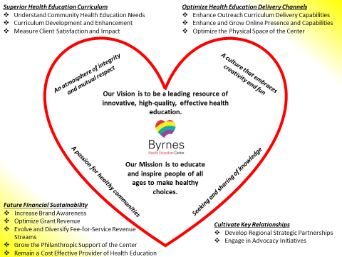
Ingredient #4: Example of Plan Communication

Slide 15
Ingredient #5: Connected to Staff Work Plans
Makes the connection from the big picture to “what can I do to help?”
Communicates to staff that everyone is responsible for the future success of the organization and what they are expected to do
Also applies to Board and committee responsibilities.
Do you directly link staff work plans to the strategic plan? Why or why not?
How do you effectively assign responsibilities to committees and the Board?

Slide 16
Ingredient #6: Implementation Tool Guides Activities
Sequential layout of the objectives with assignments, timelines and status
Accountability is shared
Contingencies are recognized
Expectations are set
Progress is communicated to staff and Board on a regular basis
Do you regularly report the progress of the implementation of your plan to the Board? How?

Slide 17
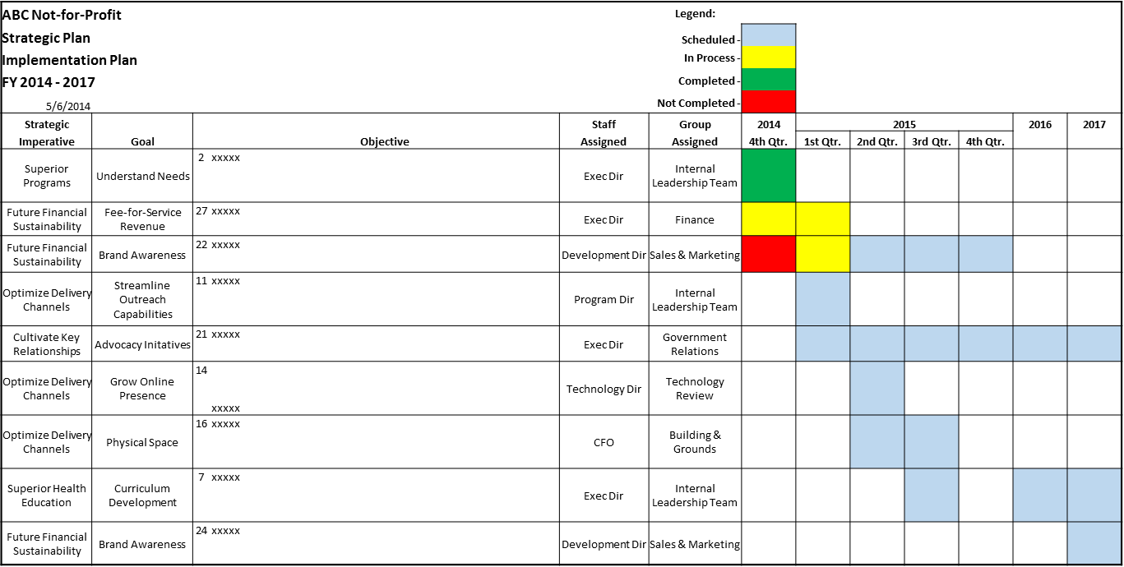
Ingredient #6: Example of an Implementation Tool

Slide 18
What Will You Do Differently?
What will you do differently….
the next time you create a strategic plan?
to ensure your current or next strategic plan is successfully implemented?

Slide 19
Closing Thoughts…
Involve the right people – be inclusive
Understand strategic planning is a process – not one meeting
Communicate the plan – be inclusive
Involve staff in implementation – personal accountability
Measure implementation - transparency

Slide 20
Questions? Comments?
Patrick Ball, President & CEO
pball@ctyconsulting.com
www.ctyconsulting.com

